Slide 1
Regional Overview and Good Practices
“Definition of I4.0 public policy initiatives”
António Grilo
Universidade NOVA de Lisboa
19 November, 2019 3rd Transnational Thematic Meeting, Lisboa

Slide 2
Definition of I4.0 Public Policy Initiatives: Proposed Methodology
In-depth Analysis of Portugal’s I4.0 Public Policies
Analysis of Partners’ Regional / National I4.0 Public Policies
Cross Country Comparison
+
Good Practices & Case Studies
Overview of other EU Regional / National I4.0 Public Policies
Overview of other countries National I4.0 Public Policies (US, Japan, China, Australia)
Report on “Lessons from I4.0 Public Policy Initiatives”

Slide 3
Portuguese I4.0 Public Policy since 2017
The i4.0 strategy was built using a bottom-up strategy, listening through interviews, workshops and auditions, 88 companies – coming from 4 fields of business relevant to the Portuguese economy for their number and importance and their level of preparation for the technological adoption
– as well as 25 other entities – of various kinds such as academic institutions’, institutes or associations – from April to June 2016, who proposed a set of measures to accelerate the adoption of industry 4.0 by national companies.
64 public and private
initiatives

Slide 4
Portuguese I4.0 Public Policy
Human Resources Capability and Capacity
Cooperative Ecosystem
Startup i4.0
Funding / Investment support
Internationalization
Legal and Standards Adaptation

Slide 5
Good Practice ESIF
Very strong re-alignment of public funds towards I4.0 – based projects.
Extremely high demand from Industrial & ICT companies
Since 2017
3948 projects for a total of 5.000 Million Euros in investment
1137 funded projects for a total of 763 Million Euros investment funding

Slide 6
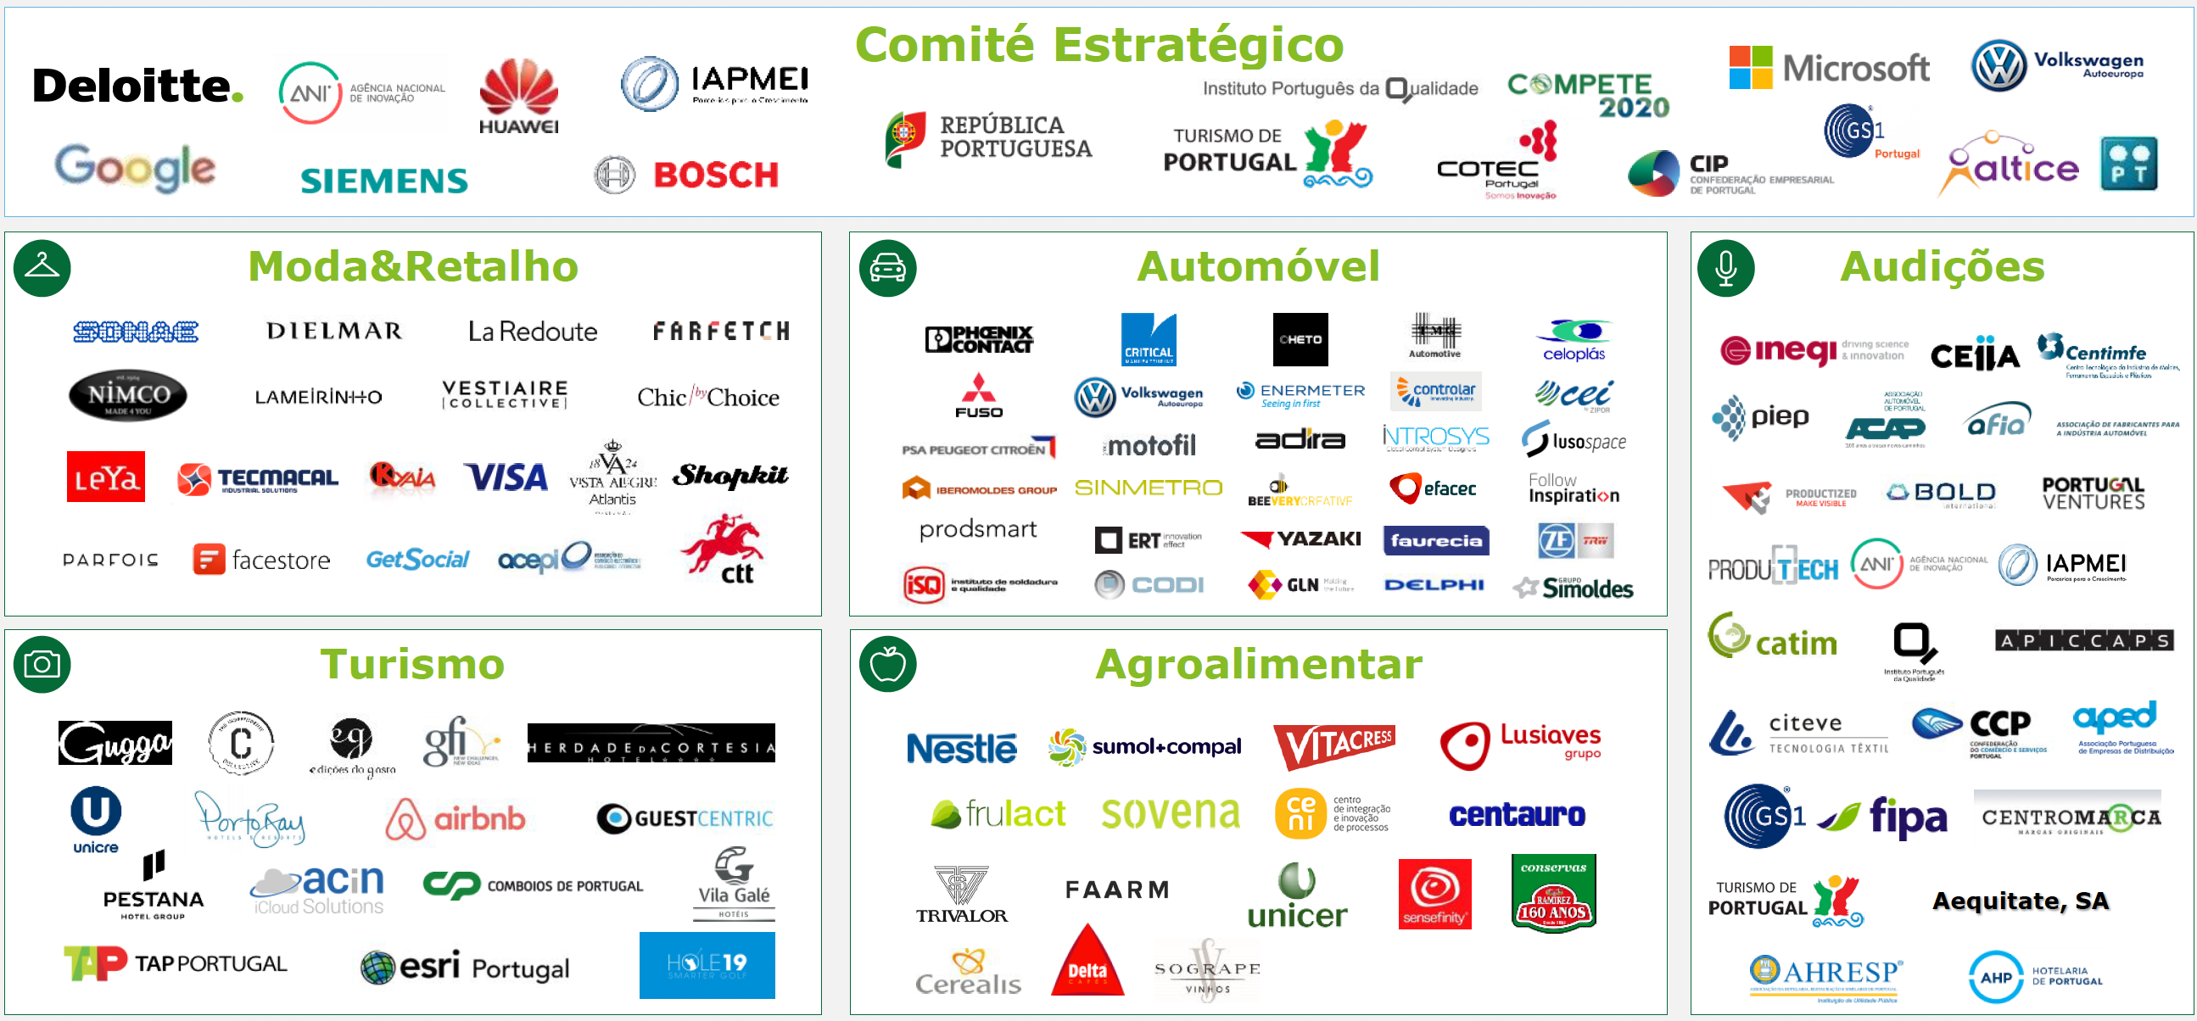
Good Practice General Policy: Bottom-up Approach

Slide 7
Good Practice General Policy
2018

Slide 8
Thank you!
Questions welcome

