Slide 1
Regional Overview and Good Practices
„Definition of I4.0 public policy initiatives”
Regional Council of Kainuu, PP8
19 November, 2019 3rd Transnational Thematic Meeting, Lisboa

Slide 2
Regional I.4.0 Public Policy Initiatives
General overview of I.4.0 regional public policy initiatives concerning R&D&I, trainning, qualification, regulations, startups,
Links for site(s) initiatives
Summary
…
2 or 3 pages

Slide 3
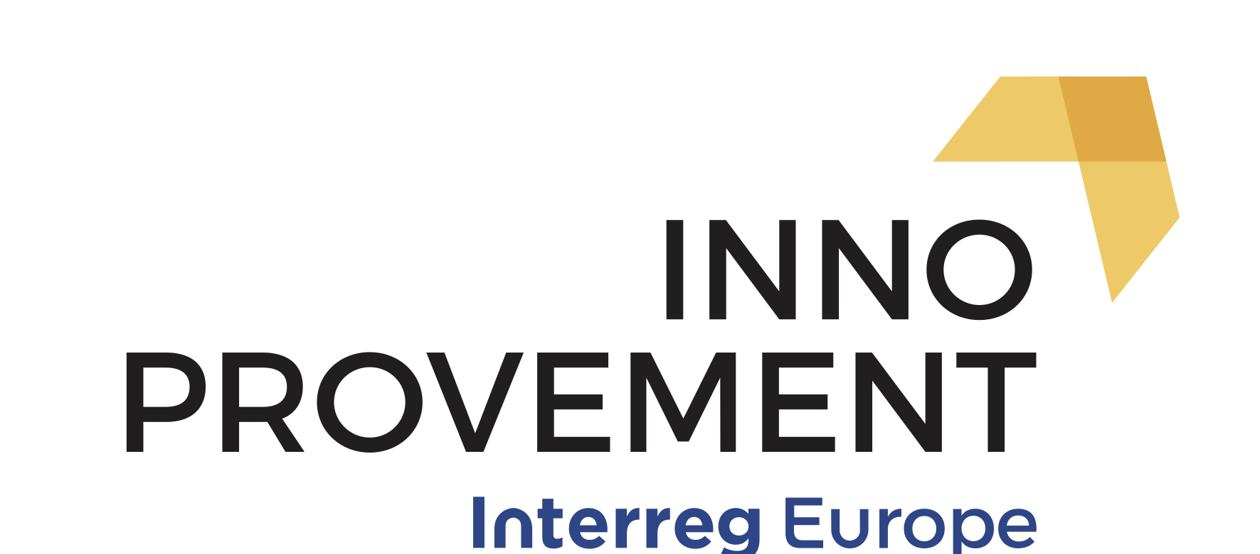
National I.4.0 Public Policy Initiatives
In Finland, there is no distinct Industry 4.0 policy.
Industry 4.0 is part of Finland’s overall Industrial, Innovation and Digitisation policies. Digitisation, especially through Artificial Intelligence (AI) initiatives is a policy in its own right involving the uptake & production of AI solutions.
Digitisation policy: Digitisation has been a priority in Finland since the 1990s, and today’s performance is especially encouraging. In December 2017 Finland launched a national artificial intelligence (AI) strategy aiming at turning Finland into a leading country in the application of artificial intelligence.
Finland’s 2014-2020 Structural Funds provide an enabling framework for applying Industry 4.0 solutions. Investment priorities 2 (Investment priority 2. Supporting SMEs so that they can grow in the local, national and international markets and take part in innovative processes; page 43) and 3d (3d - Supporting SMEs so that they can be part of the growth in the local, national and international markets and innovative processes; page 46) provide excellent opportunities for the uptake of Industry 4.0
SOURCE: Policy instrument assessment report for Kainuu region, Finland , January 2019

Slide 4
Regional I.4.0 Public Policy Initiatives
The Kainuu regional development programme
In the Regional Development Programme of Kainuu, Industry 4.0 is described under the Smart Specialisation approach. Industry 4.0 solutions are described as cross-cutting themes through all chosen spearheads of the RIS3 strategy. Digitisation priorities are discussed in appendix 2 (values and cross-cutting views of development work), page 52. In the Regional Action Plan of the Structural Funds and Rural & Agriculture Funding industry 4.0 is emphasised in chapter 1.3.
The prioritised industries of smart specialisation are 1) measurement technology, gaming & simulators, and innovations in metal industry 2) process and environmental monitoring of bio-based economy, mining and innovations of forest, food and blue bio-based economy industries, 3) activity tourism on social and welfare sector and innovations in health and sports sector.
The Kainuu RIS3
The approach of Kainuu Smart Specialisation strategy differs from the traditional development activities of regional spearheads of economic activities by its choice to emphasise high level of know-how, as well as research and innovations and the supporting educational activities. The spearhead fields in general are developed as an entity covering everything from the basic know-how needed to excellence and the infrastructure related to activities.
SOURCE: Policy instrument assessment report for Kainuu region, Finland , January 2019

Slide 5
Regional I.4.0 Public Policy Initiatives
Project criteria for promoting Industry 4.0
Selection process of projects to be funded goes through many stages. After the compulsory prerequisites, project proposals have to prove their relevance to the programme or call.
Industry 4.0 – related proposals have to fulfill at least some of the following criteria.
RDI activities in order to show the technological change project is targeting
RDI cooperation between different RD units or working together with private sector and educational institutions triple helix / quadruple helix
Smart specialization connections to the programme
Knowledge intensive activities
Promoting low carbon economy
Using digitization as a game changer
Projects are supposed to bring added value to whole region through the implementation of the proposals.
SOURCE: Policy instrument assessment report for Kainuu region, Finland , January 2019

Slide 6
Good practices relevant to I.4.0
I.- AWARENESS RAISING & TRAINING / ADOPTION OF I.40 RELATED SOLUTIONS
I.1/ Woodpolis 2020 (1.1.2018–31.12.2020, Total budget 756 000 €, ERDF+state funding 535 600 €): Wood product industry (production) is aiming at the possibilities of digitisation and modern machines & equipment to make production more efficient. Future possibilities, ecology of production (low carbon production), renewable raw material – material wise and production wise (heath/electricity), automation in production. Support services are important part, maintenance and reliability – all need to be digitised in the long run to achieve competitive advantage.
I.2/ BIOMIT (1.1.2017-21.12.2018, Total budget 924 500 €, ERDF+state funding 647 200 €): The BIOMIT project focus is developing measurement and pre-treatment solutions for bio-economy, mining, forest and paper industry to improve their efficiency and decrease toxic emissions to the environment. The project is divided into five work packages: 1) Development and increasing the knowledge of modelling complex processing systems; 2) Development of pre-treatment and measurement solutions for process industry; 3) Pilot tests for measurement solutions in the industry; 4) Development of mathematical models and reliability for data management, 5) Administration, communication and business development (connection to KANTELI project): company and project co-operation.
The main results of the project are: development and piloting 4-5 technologies which improve industrial process control and decrease toxic emissions to the environment and furthermore enable new entrepreneurship in the field of bio-economy in the Kainuu region. 1-2 international pre-reviewed scientific articles / conference papers and national and international project funding.
SOURCE: Policy instrument assessment report for Kainuu region, Finland , January 2019

Slide 7
Good practices relevant to I.4.0
I.- AWARENESS RAISING & TRAINING / ADOPTION OF I.40 RELATED SOLUTIONS
I.3/ Data analytics accelerator (1.5.2018-30.4.2020, Total budget 346 000 €, ERDF+state funding 240 000 €): Data analytics, big data and artificial intelligence are the major tools for modern companies to achieve large-scale competitive advantages. The target of this project is to speed-up the up-take of data analytics methods in regional companies and in the Kainuu region as whole. The project creates a straightorward process for companies and institutions to quickly try out the possibilities of data analytics and to launch new data driven solutions.
The project consists of data analytics pilot projects with approximately 3 companies, workshops with 10-15 companies and outreach activities for even a larger number of companies. This improves the know-how and practical experience of data analytics in the regional businesses significantly. The data-analytics accelerator provides the necessary first push for adapting new methods, which otherwise would required major investments and competence from the participant companies.
The project results in improved usage of data analytics through three channels. The deepest effect comes from pilot projects, where the data analytics capability of the participating companies can be developed on a longer term. Wider reach comes from workshops, where the work focuses on real-world questions posed by the companies and translating the concepts of data analytics into the everyday life of the participants. In addition to these results the project also runs outreach activity to educate local companies and institutions about the possibilities of data analytics and success stories from the project. The project produces quick improvements to companies' processes, but also improved understanding that benefits business development in the long run.
SOURCE: Policy instrument assessment report for Kainuu region, Finland , January 2019

Slide 8
Good practices relevant to I.4.0
II.- I4.0 INNOVATIONS, PRODUCTION & TESTING
II.1/ Robotics for Kainuu (1.2.2016-31.3.2019, Total budget 306 300 €, ERDF+state funding 214 400 €: The aim of this project is to build up facilities for teaching and learning robotics in companies and in learning institutions KUAS and KVC in Kainuu region and to improve and raise the knowledge and skills concerning robotics and automation linked with it. In addition, this will guarantee the sufficiency of professionals in the future.
Two of the learning facilities will be built in companies, robot welding station and movable service robot cell for NC machining. Two facilities will be placed in the learning institutions. They are piece handling and packaging robot cell and stationary service robot cell for NC machining. Moreover, several cooperative robots will be purchased to be used both in companies and learning institutions for many kinds of tasks, as well as health and care robotics competence will be acquired.
SOURCE: Policy instrument assessment report for Kainuu region, Finland , January 2019

Slide 9
Good practices relevant to I.4.0
II.2/ OredVR (1.1.2018-31.12.2019), Total budget 349 900 €, ERDF+state funding 244 900 €): The OredVR project adds to the knowledge on how mining companies can use virtual reality and augmented reality in visualising ore deposits for different user groups in the value chain of a mine. The OredVR project creates a virtual reality/augmented reality platform for visualising ore deposits. This platform utilises the different data mining companies collect from the site, as well as other relevant data (such as market prices) from outside sources. The platform integrates and processes the data to produce that 3D visualisations that can be utilised for different operations with, depending on the need, virtual reality (VR) or augmented reality (AR). It will have separate interfaces for several different users (e.g. executive level, mineral processing personnel, loading personnel, exploration planning). In addition, efficient ways for handling big data in mining environment are developed in the project.
SOURCE: Policy instrument assessment report for Kainuu region, Finland , January 2019
T

Slide 10
I.4.0 Public Policy Initiatives
CONCLUSIONS
Industry 4.0 is not a priority in the current RIS3.
Project criteria relating to I 4.0 exist and we believe they are good.
Several projects have been implemented, we have selected 5 as good practices.
The comprehensive approach is missing.
A more targeted, cohesive and generalised approach relating to I4.0 adoption and in parallel, supporting production of I4.0 innovations seems relevant.
Advanced manufacturing, I4.0 and trans-regional (national, transnational, interregional) solutions for cooperation and access to expertise, will be included in the RIS3 revision (on going call for offers currently).
The above background was important in the elaboration of the 2nd thematic document.

Slide 11
Key findings from the 2nd thematic document
Key benefits
(1) Potential for product customisation: Additive manufacturing is an example of a tool facilitating this process. Additive manufacturing (3D printing, whereby a 3D model is created by CAD software can be used to produce an item by building up successive layers of a material (plastic or metal)).
A first benefit is having the potential to produce much more complex components than before.
A second benefit is how fast and cheaply new / differentiated product components can be produced.
(2) Personalised medication: personalised medication is a patient-focused process that incorporates both, medication and the dispensing process.
(3) Collective constructions internet-based building management systems (e.g. light, temperature, humidity) adapted to each individual resident’s preferences
(4) New market is developing fast towards productising components for Industry 4.0 applications (Building the foundations for an Industrie 4.0 ecosystem: Platform Industrie 4.0 publishes a blueprint for the smart networking of assets).

Slide 12
Key findings from the 2nd thematic document
I4.0 and traditional SMEs
OVERALL FINDING
SMEs’ motivation and readiness towards adopting I 4.0 require straightforward, tailored business model (-s), and such model (-s) is /are missing. Therefore, such models such be included into several policies such as research, education and regional policies.
READINESS FOR ADOPTING I4.0
Conceptual readiness: I4.0 means to a business environment, is about digitising (automating, self-regulating, self-assessing and interlinking) business & production modules
Attitudinal readiness: Traditional SMEs hesitate to invest in advanced solutions unless the relevance of the solutions is demonstrated.
RELEVANCE
Returns to scale: For any business, traditional SMEs included, the trade-offs between investments and gains related to Industry 4.0 must be clearly outlined and demonstrated. Among the most important reasons for SMEs to adopt I4.0 solutions is linking to value chains.

Slide 13
Strategic contribution to the industry renewal: from light pink to light green

Slide 14
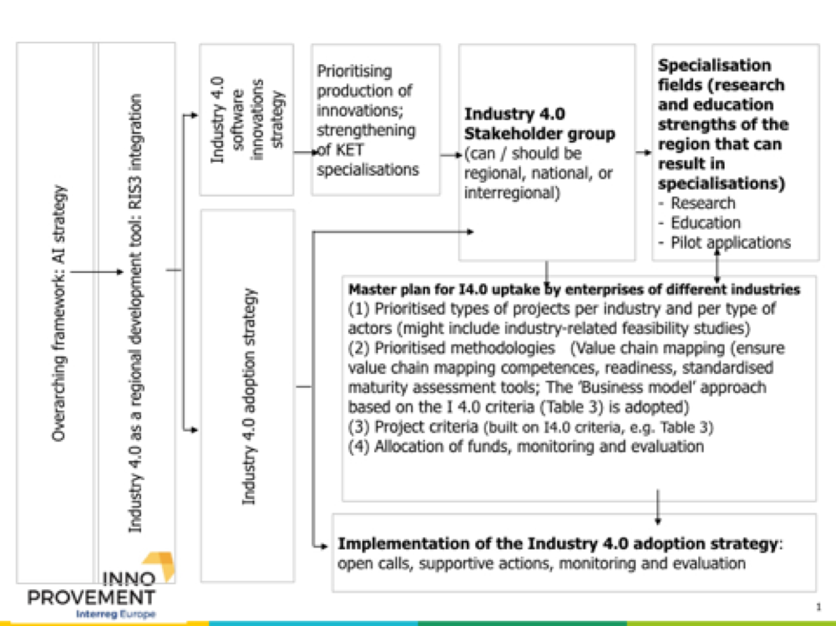
Policy impact in Kainuu, state of play
I 4.0 main concept presented during the 1st RSG, 12-5-2019.

Slide 15
Policy impact in Kainuu
RIS3 impact (on going RIS3 revision & preparation for the next period)
Introducion to and adoption of I4.0 by traditional industries
(Regional Council of Kainuu, Finland)
Production of I4.0 innovations
(Regional Council of Kainuu, Finland)
MODEL
FEASIBILITY STUDY to facilitate the action plan formulation
Once all the thematic units inputs are known
LEARNING FROM IMPLEMENTED THEMATIC ANALYSES
Thematic document 1 ——> Considering evaluation indicators for the RIS3
Thematic document 2 ——> Barriers traditional SMEs face in respect to I 4.0 and ways to address them
EXPECTATIONS FROM THEMATIC UNITS 4 & 5
Thematic document 4 ——> Considering themes for integrating I 4.0 into the RIS3
Thematic document 5 ——> Comparing I 4.0 maturity evaluation matrices to lead to business and skills projects in the forthcoming RIS3 revision.

Slide 16
Policy impact in Kainuu, state of play
CONCEPT presented and discussed during the 2nd RSG, 2.10.2019
REGIONAL POLICY: RIS3 integration: I4.0 is one of the KETs, i.e. a precondition for the RIS3 implementation. I 40.0 integration means concrete project criteria and initiatives. Two lines of action: uptake of I 4.0 and production of I 4.0 innovations.
1) UPTAKE OF I 4.0 BY TRADITIONAL SMEs
1/1) “Business models for Industry 4.0 uptake”. This implies comprehensive programmes, awareness raising, business models introduction, participation in policy platforms, Ref: Tables 1, 2, and 3.
1/2) “Reinforcing and facilitating access to value chains”. Initiatives for getting traditional SMEs integrate into performing value chains and in the process support I 4.0 uptake.
2) PRODUCTION OF I 4.0 INNOVATIONS
2/1) “Strengthening the I 4.0 research & skills base in Kainuu”
2/2) “Pilot actions for linking Kainuu I4.0 research results to businesses (local, national and EU)”
2/3) “Supporting spin offs for the commercialisation of Kainuu I4.0 research results”

Slide 17
Policy impact in Kainuu, state of play
Results from the regional stakeholder group meeting on 2.10.2019
—-> To map Kainuu traditional businesses in terms of I 4.0 absorption readiness
—-> Conclusion: one part of the Kainuu feasibility study to be dedicated to this mapping.

Slide 18
Thank you!
Questions welcome

